Slide 1
MODULE ON MEDIA PLANNING

Slide 2
Media Plan
EFFECTIVE
REACH
FREQUENCY
DISTRIBUTION
GRP’s
& TVR’s
CPT’s
or CPM’s
CIRCULATION
& READERSHIP
CPRP’s
TARGET
AUDIENCE
COVERAGE
or REACH

Slide 3
So much jargon…
what does it all mean ?

Slide 4
BASIC
MEDIA
TERMINOLOGIES

Slide 5
Target Audience
The total potential audience that we would like to communicate to
  SEC
  SEX
  Age

Slide 6
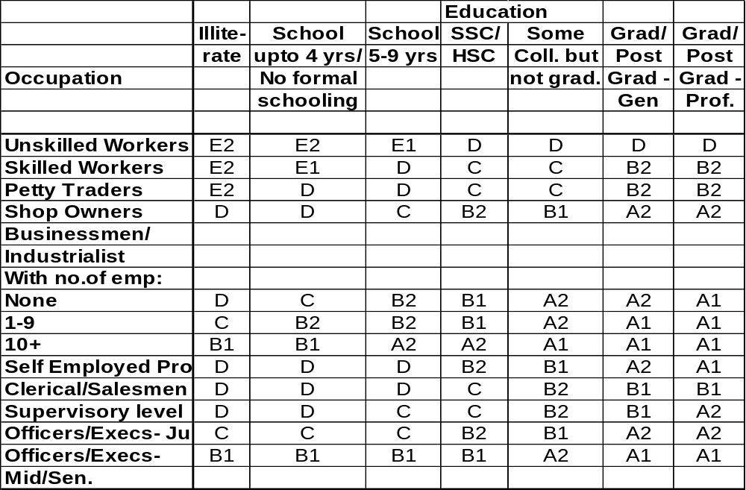
SEC GRID

Slide 7
Reach of media (Max. Poss)
Of the total audience the maximum number of people that the medium covers.

Slide 8
Television
  The number of people who watch television at least once a week.
Press
  The number of people who read any publication at least once a week.
Radio
  The number of people who listen to radio at least once a week.
Cinema
  The number of people who visit cinema at least once a month.

Slide 9
Media Penetration
It is the percentage of homes in a specified area and TA that own at least one TV or radio set or have a TV with a C&S connection.
Different from Reach

Slide 10
Television Ratings (TVR)
The % of audience exposed to a particular programme
  Peoplemeter TVRs
    A time averaged % of the audience universe across a defined time period

Slide 11
Time weighted TVR...
Viewer Start End Total time viewed (min.)
A 8.30 8.40 10
D 8.46 8.50 4
F 8.30 8.35 5
J 8.33 8.58 25
B/C/E/G/H/1 - - -
(Did not watch)
Calculation as per the Diary Method
Reach ( 5 MIN.+ for A, F & J) : 3 / 10 x 100 = 30 TVR
Calculation as per the People Meter Method
Time Weighted. TRP : 10/30 + 4/30 + 5/30 + 25/30 x 100 = 15 TVR
10
Note : The figure 30 in the numerator is the duration of the programme

Slide 12
Gross Rating Points (GRP)
A measure of gross message weight
    It is a % duplicated figure
A summation of all the TVRs for a particular media schedule
Alternately: GRP = Reach x AOTS
A GRP is always a comparative weight…by itself, it has no relevance.

Slide 13
The relationship...
GRP
GRP=Reach X AOTS
AOTS
A=GRP/Reach
Reach% at 1+
R=GRP/AOTS

Slide 14
Reach (%)
The net unduplicated number of people that the plan covers at least once in the defined period

Slide 15
Reach
Definition : The percentage of the target audience who saw the commercial at least once during a given campaign period

Slide 16
Reach
Definition : the percentage of the target audience who saw the commercial at least once during a given campaign period.
In practice :
Programme
Kyunki Saas...
Amanat
Movie
Heena
News
TVR
15
7
9
4
2
37 GRPs
Unduplicated Reach
15
6
7
3
1
32%
Cumulative Reach
15
21
28
31
32
32% Reach

Slide 17
Plan reach (%)
TG = 300
Veh A
100 people
Veh B
80 people
20 people read pub. A and pub. B

Slide 18
Plan Reach (%)
TG = 300
Total readers = 80
Total readers = 100
Veh A
80
Dup
20
Veh B
60
Plan reach = Total (A + B) - Dup (AB) or Exclusive (A+B+C)
{(100 + 80) - 20} or {80+60+20}
= 160

Slide 19
Plan reach = (160/300) x 100
= 53 %

Slide 20
Average OTS
Definition :The number of times, on average, the audience reached sees the commercial during a given period.
Formula : AOTS = Total GRPs ÷ Reach or
GRPs = Reach x AOTS

Slide 21
Definition : The number of times, on average, the audience reached sees the commercial during a given period.
Formula: AOTS = Total GRPs ÷ Reach
or
GRPs = Reach x AOTS
In Practice: 37 GRPs ÷ 32% Reach = 1.16 AOTS
Therefore, 32% of the target audience will see the commercial on average 1.16 times during the given period.

Slide 22
The relation between Reach & AOTS ...

Slide 23
Inversely proportional

Slide 24
Determines Reach
Determines AOTS
When the duplication is lower
Reach increases and AOTS decreases
When the duplication goes up
Reach decreases and AOTS increases

Slide 25
Effective Frequency
The number of times a message needs to be exposed to the TG to make it relevant
The OTS that works :
    The optimal OTS to be achieved within a time frame to accomplish a specified objective
    The frequency estimator one such tool.

Slide 26
Effective Reach
The reach at effective frequency that is needed to accomplish the specified objective

Slide 27
CPT
Cost Per Thousand :
  A measure of cost effectiveness.
  The cost of a unit (10 secs) of a vehicle/ the total number of target audience reached by the vehicle in thousands.

Slide 28
Cost Per GRP
Definition : The cost of buying one rating point.
Formula : Cost ÷ GRPs = Cost per GRP

Slide 29
Cost Per GRP
Definition : The cost of buying one rating point.
Formula : Cost ÷ GRPs = Cost per GRP
In Practice : Rs .250,000 ÷ 15 GRPs =
Rs. 2174 cost per GRP

Slide 30
Quick Quiz
The following schedule was constructed against the target audience Housewives 18-49 years. The campaign cost is Rs 8 lakhs.
Programme
Kyunki Saas...
Amanat
Movie
Heena
Meri Saheli
Ramayan
Ally Mc Beal
Ghar Ek Mandir
TVR
15
7
9
4
2
5
1
5
Unduplicated Reach
15
6
7
3
2
2
1
1
37%
Cumulative Reach
15
21
28
31
33
35
36
37
37%
1) What GRP’s did this campaign achieve?
2) What is the AOTS ?
3) What is the cost per GRP?
4) If Ghar Ek Mandir was not on the schedule, how many GRPs would the
campaign have achieved and what would the campaign reach have been?

Slide 31
Quick Quiz - Answer 1
The following schedule was constructed against the target audience Housewives 18-49 years. The campaign cost is Rs 8 lakhs.
48
Programme
Kyunki Saas...
Amanat
Movie
Heena
Meri Saheli
Ramayan
Ally Mc Beal
Ghar Ek Mandir
TVR
15
7
9
4
2
5
1
5
Unduplicated Reach
15
6
7
3
2
2
1
1
37%
Cumulative Reach
15
21
28
31
33
35
36
37
37%
1) What GRP’s did this campaign achieve?
2) What is the AOTS ?
3) What is the cost per GRP?
4) If Ghar Ek Mandir was not on the schedule, how many GRPs would the
campaign have achieved and what would the campaign reach have been?

Slide 32
Quick Quiz
15+7+9+4+2+5+1+5
=48 GRPs

Slide 33
Quick Quiz - Answer 2
The following schedule was constructed against the target audience Housewives 18-49 years. The campaign cost is Rs 8 lakhs.
1.3
Programme
Kyunki Saas...
Amanat
Movie
Heena
Meri Saheli
Ramayan
Ally Mc Beal
Ghar Ek Mandir
TVR
15
7
9
4
2
5
1
5
Unduplicated Reach
15
6
7
3
2
2
1
1
37%
Cumulative Reach
15
21
28
31
33
35
36
37
37%
1) What GRP’s did this campaign achieve?
2) What is the AOTS ?
3) What is the cost per GRP?
4) If Ghar Ek Mandir was not on the schedule, how many GRPs would the
campaign have achieved and what would the campaign reach have been?

Slide 34
Quick Quiz
48/37 = 1.3

Slide 35
Quick Quiz - Answer 3
The following schedule was constructed against the target audience Housewives 18-49 years. The campaign cost is Rs 8 lakhs.
Rs. 16667
Programme
Kyunki Saas...
Amanat
Movie
Heena
Meri Saheli
Ramayan
Ally Mc Beal
Ghar Ek Mandir
TVR
15
7
9
4
2
5
1
5
Unduplicated Reach
15
6
7
3
2
2
1
1
37%
Cumulative Reach
15
21
28
31
33
35
36
37
37%
1) What GRP’s did this campaign achieve?
2) What is the AOTS ?
3) What is the cost per GRP?
4) If Ghar Ek Mandir was not on the schedule, how many GRPs would the
campaign have achieved and what would the campaign reach have been?

Slide 36
Quick Quiz
Rs.800000/48 =
Rs. 16667

Slide 37
Quick Quiz - Answer 4
The following schedule was constructed against the target audience Housewives 18-49 years. The campaign cost is Rs 8 lakhs.
GRPs- 43
Reach-36%
Programme
Kyunki Saas...
Amanat
Movie
Heena
Meri Saheli
Ramayan
Ally Mc Beal
Ghar Ek Mandir
TVR
15
7
9
4
2
5
1
5
Unduplicated Reach
15
6
7
3
2
2
1
1
37%
Cumulative Reach
15
21
28
31
33
35
36
37
37%
1) What GRP’s did this campaign achieve?
2) What is the AOTS ?
3) What is the cost per GRP?
4) If Ghar Ek Mandir was not on the schedule, how many GRPs would the
campaign have achieved and what would the campaign reach have been?

Slide 38
Quick Quiz
48 - 5 = 43 GRPs
37 - 1 = 36% Reach

Slide 39
Channel Shares
Out of the total TV viewing universe in the specified time period what proportion of the audience has viewed the channel.

Slide 40
Cumulative Reach
The net unduplicated number of people that have viewed a channel for at least a period of 1 min within the specified time period.

Slide 41
ROS
  Run on schedule.
  Refers to the random running of spots across the entire day
RODP
  Run on daypart
  Refers to the random running of spots within a specified time band.

Slide 42
FCT
  Free commercial time
  It is the amount of secondage that is bought on a channel.
FPC
  Fixed point chart
  It is the time wise, day wise programming grid for a particular channel.

Slide 43
Effective Rate (ER)
Used to signify the final rate/10 secs that is obtained on a channel after the buying is complete.
  It is arrived after averaging out the paid and the bonus component of the deal. For eg.
    Paid Value = Rs 150,000
    Paid secondage = 100 secs (ie @ Rs 15,000/10 secs)
    Bonus secondage = 50 secs
    Total secondage = 150 sec
    ER/10 secs = 150,000/15 = Rs 10,000

Slide 44
Scheduling
Burst
Continuous
Time
Time
Flighting
Pulsing
Time
Time

Slide 45
TERMINOLOGIES IN A COMPETITIVE FRAMEWORK

Slide 46
Share of Expenditure (SOE)
A relative media measure
Brand spend in value as a % of the total advertising expenditure of the category
Gives the first level of indication of the level of dominance of a brand in a certain time period.
Does not take into account the duration differentiation and the buying efficiencies of the different players
  Data is monitored weekly at card rates by a third party.
    In our case it is Time monitoring.

Slide 47
Share of Voice (SOV)
  A measure of media weight distribution
  Represents the brand GRP’s as a % of the total GRPs delivered by the category
  A more reliable measure of relative weights
  But not sensitive to duration.
    Avg. duration used should always be looked at in conjunction.

Slide 48
TERMINOLOGIES IN MARKET PRIORITISATION

Slide 49
Basic numbers...
Saliency or contribution:
  A percentage number
  The contribution of a state / city compared to All India or Total
  Gives you the relative importance of a state / city w.r.t other states / cities
Growth rates
  A simple linear increase / decrease in sales expressed in % across two time periods

Slide 50
Indices...
A measure of per capita consumption in a particular state / city for a brand or category w.r.t defined TG dispersion in that city.
  BDI (Brand Development index)
      % contribution of state to total brand sales / % TG popl in that state to total TG
  CDI (Category Development index)
      % contribution of state to total category sales / % TG popl in that state to total TG
  Help inter-state comparisons and relative media weight setting.

Slide 51
Mapping for prioritisation...
High CDI
Invest Potential
Consolidate/
Strengthen
Low BDI
High BDI
Ignore/Spillover
Maintain/Threshold
Low CDI

Slide 52
ZOOMING IN ON PRINT...
Press terminologies & concepts

Slide 53
Readership
Average Issue readership
  A percentage / portion of the audience who read the vehicle within the periodicity of it being published
  Also referred to as reach of vehicle
Sole Readers
  A percentage / portion of the audience who reads only a particular vehicle and nothing else

Slide 54
Cost efficiency
CPT (Cost per thousand)
  Cost of a defined creative unit say 100 cc or Full Page/ the readership in thousands.
CPC (Cost per copy)
  Cost of a defined creative unit say 100 cc or Full Page/ the circulation in thousands.

Slide 55
Newspapers / Magazines
Circulation
Definitions : The number of copies each edition sells.
In Practice : The Readers Digest has a circulation of 58,000 copies.
Readership
Definition : The total number of adult readers for each title.
In Practice : The Readers Digest has a circulation of 58,000, but an average of 8.5 readers per copy.
Total Readership = 8.5 x 58,000 = 493,000

Slide 56
NET TERMINOLOGY

Slide 57
Terminology…
Uniform Resource Locator (URL)
  An Internet address
  A means of identifying an exact location on the Internet
  http://www.rediff.com
HTML (HyperText Mark-up Language)
  The set of codes that tells the web browser how to display the page

Slide 58
Terminology…
Rich Media
  Ads with Rich Media use Java, Flash, Shockwave to generate banners with animations, form submissions etc.
  Interaction with the user
Cookie
  A packet of data stored on your computer’s hard drive by a Web site
  The code reveals info about you (pages you’ve visited, utilities used, etc.) that can be used for targeting of ads

Slide 59
Terminology…
Hit
  A hit is generated by every request made to a web server.
  Eg. The Inbox, Compose etc. on Hotmail are treated as different hits
Impression
  One display of a banner to a single viewer
Page View
  One download of a complete page

Slide 60
Terminology…
Unique visitors
  The number of unique individuals who visit a site within a specific period of time

Slide 61
WHILE PLANNING QUESTION YOURSELF….

Slide 62
1.What is the marketing/sales objective?
hold current users
change user profile
grab users from competition
expand category ie.new users
get current users to use more

Slide 63
2.What is the objective behind the current burst ?
Specific sales objectives (if measurable)
Brand task - Introduce, Maintain, Stimulate, Reposition, Re-launch

Slide 64
3.What is the role of advertising ?
Increase awareness (measurable), generate trials etc.
Will impact coverage, continuity, dominance, frequency objectives in the plan

Slide 65
4.Which are the focus markets?
Mkt. wise sales salience over at least 4 data points (by quarter)
Helps in market prioritisation and relative media weight allocation

Slide 66
5.What is the competitive set ?
What are their regional pockets of strength ?
Helps us look at the media in the context of the overall marketing plan to counter competition
How is the category moving - growths, rural vs urban etc. ?

Slide 67
6.What is the brand's distribution status by geography, compared to the competition & category ?
Can lead to a decision to delay media break in a mkt due to below -threshold distribution

Slide 68
7.Who are we talking to ?
Demographics
Psychographics

Slide 69
8.Where are current users coming from ?
(if not a new brand) TG definition & geography
Can help identify the strong pockets
Can impact the relative media weights for each market.
  (Reach for width & frequency for depth)

Slide 70
9.Where has been the maximum lapsing and why ?
(if applicable)
Can link this to media weights given. Redefine threshold if there is a only media solution

Slide 71
10.How much are the resources ?
Budget determined by client, allocated by agency

Slide 72
11.Are there any special considerations that we need to bear in mind ?
Any market/category peculiarity that could impact the planning process
  Client deals, below the line activities, seasonality, purchase cycle etc.

Slide 73
12.Are there any creative size mandatories ?
Existing creatives
New creatives with size restrictions

Slide 74
THE MEDIA PLANNING PROCESS

Slide 75

The Unifying:M factor...
Money...Marketing...Media
My Kitty

Slide 76
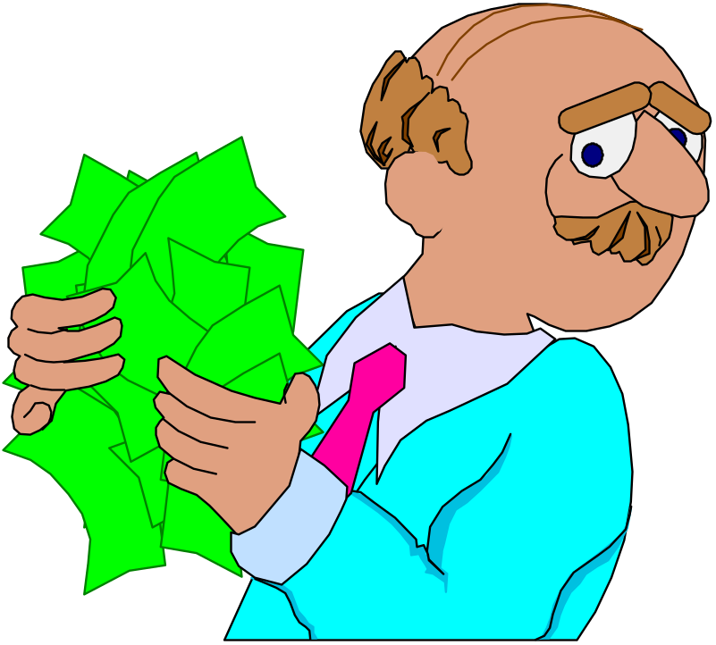

Now that I have it,
what do I do?
Four key questions:
To whom
Where (mkt & broad mix)
How much
How & When (specific)

Slide 77
To Whom...

Slide 78
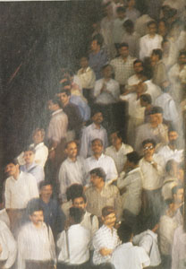

To whom...
Demographics
  Primary vs secondary
Psychographics
Mediagraphics
  C&S vs NC&S

Slide 79

Where - Markets...
Market Prioritisation
  Salience (% contribution)
  Growths
  Mkt wise share movements - competitive factors
  Distribution

Slide 80
How does our audience relate to his/her media environment
Where ...
Context of media

Slide 81

The juggle...
Arriving at the right media mix

Slide 82
Why a medium...
Each medium has some inherent capabilities
  TV - a-v/active - emotional/demo
  Press - high involvement - information detail
  Radio - audio/passive - imagination/intimate
  Cinema - audio visual/unadulterated attention
  Outdoor - transient - announcement/localised
  Internet- interactive – one on one

Slide 83
Why a mix...
Extend the reach beyond a single medium
Highly fragmented mkts
If the brand is targeting two different TG
  different strokes for different folks
Different stimuli aid in making the communication more memorable
  Media multiplier
  Launch impact

Slide 84
Quantitative...
Maximum possible reach of a medium (Max Pos):
  How does a medium fare in numeric terms within our defined audience
    Eg: FM for teenagers, Women focus mags for women etc.

Slide 85
Qualitative...
Involvement
  This adds the qualitative layer and gauges not just the numbers but also the quality of the interaction with a medium.
  Average time spent ( Heavy/ medium /light.)
  Context of use.

Slide 86
Planning in a competitive context
Not always actionable insights but a critical backdrop.
  MAP- Press (monthly)
  Medialogist - TV (weekly)

Slide 87
Competitive Tracking - Press
Spends across brands on a regular basis
Spot key trends
  Type of publications used
  Periodicity (Dailies v/s Magazines)
  Colour v/s B&W
  Seasonality
  Specific positions
  English v/s language press

Slide 88
Competitive Tracking - TV
Spends across brands on a regular basis
Spot key trends
  Channel mix
  Terrestrial vs satellite focus
  Regional vs national focus
  Average duration of spot
  Scheduling pattern

Slide 89
Reach
Vs
Frequency

Slide 90

How much...
To get some jargon into perspective:
  Reach
  Frequency/OTS
What is effective ?
75% @ 3+

Slide 91
Frequency based weight setting

Slide 92
Frequency :
‘How much is enough’
Krugman’s three hit theory :
  1st exposure : What is it ? A cognitive (screening out/ in) response
  2nd exposure : What of it ? An evaluative response
  3rd exposure : The true reminder
  All subsequent exposures : Repeats of the 3rd exposure

Slide 93

How much is enough ?
Given the budgets:
  Setting Effective frequency targets and optimising reach at those levels
The tool used:
  “The Effective
  Frequency Estimator”
Media wt.
Poor
consumer

Slide 94
About the estimator...
A model for arriving at an optimal frequency level for a brand in a particular market.
Parameters used
  Brand (Awareness) related
  The media/market environment
  Communication factors

Slide 95
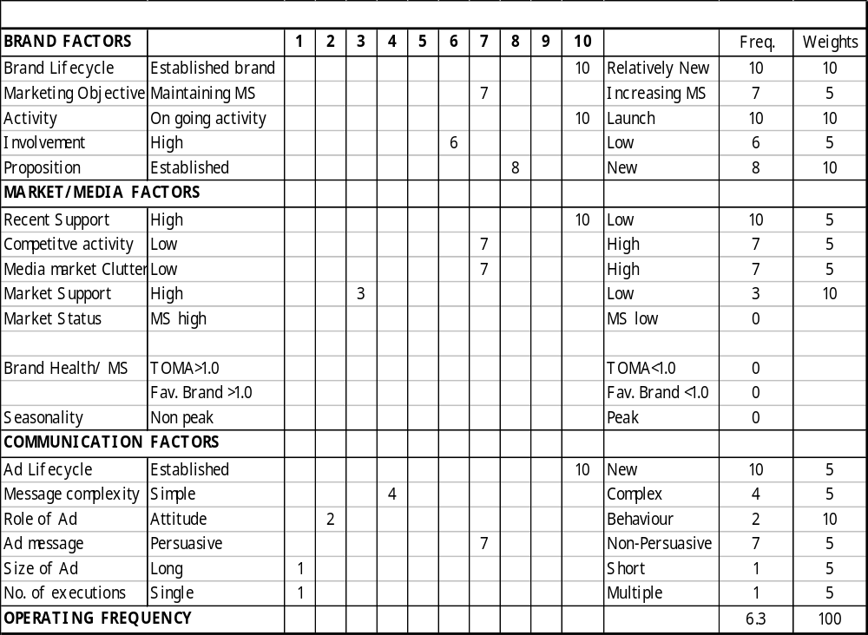

Slide 96
Reach based weight setting

Slide 97
Setting reach objectives
Goal Orientation
This approach is a bottom-up approach, which flows from expected sales. An illustration :

Slide 98
Setting reach objectives
TG (Sec A/B, Rs.4000+, Women) =20,00,000
Sales estimate =100 Tons
Avg. consumption/TG HH in =250 gms
campaign period
Total consuming TG HH (2) / (3) = 4,00,000 (20% of TG)
Conversion ratio = 40%
(Awareness to Trial possible measure)
Therefore reach (4) / (5) = 50% of TG

Slide 99
Setting reach objectives
Maximising Efficiency
This approach is strictly quantitative in nature, with the primary objective of maximising efficiency. It can be applied only when effective frequency objectives have been set.

Slide 100
Setting reach objectives
The point on a reach/frequency curve where diminishing returns set in defines reach objective.
3+
80%
4+
5+
Reach %
GRPs / Cost

Slide 101

The Recipe for a Media Plan
A closer look at the cooking...

Slide 102
Defining Objectives-by TG and Task
TG :
Men for Citibank credit cards
Youth for Valentine’s Day
Task :
Rapid Reach build up to induce trial
Higher frequency at threshold Reach for repeat purchase

Slide 103
The Print Process ...
Defining Objectives
Evaluation of vehicles
Plan iterations (reach/costs)
Vehicle selection
Quantitative
Qualitative
FINAL PLAN
Deliveries
Schedule

Slide 104
The Television Process ...
The Task
Budgets
How much is enough?
Defining Objectives - Reach/Freq.
How do I get there ?
Programme selection

Slide 105
The Television Process ...
Plan construction
and iterations (reach/costs)
FINAL PLAN
Pre-plan Deliveries
Schedule
Monitoring
Post plan deliveries

Slide 106
The Outdoor Process ...
Defining Objectives
(based on campaign, TG, markets, budget)
Site selection
Quantitative(size)
Qualitative(location)
Site monitoring
Site operation(Painting, vinyl)

Slide 107
The internet process…
Defining objectives
(driving traffic/visits, building awareness)
Defining TG
(affinity groups, usage data)
Choosing a model
(banners, sponsorships/branding, email marketing, referrals, keyword searches, contests)
Targetting options
(by country, city, time, day, demographics, content, geographic location)
Evaluating a plan
(Site centric / user centric)

Slide 108

Beyond the numbers
The “feel” aspects …

Slide 109
Qualitative factors
I . The choice of a vehicle…
Clutter
Reproduction/Reception quality
Editorial/programming environment
  TOI v/s Midday
  Star Plus v/s MTV
Flexibility of publication/TV channel
II. Treatment of the vehicle…
Supplements v/s Main issue
Spots v/s Sponsorships
Page position/break position

Slide 110
Plan Iterations
Begins after selection of the final basket of vehicles
Build in insertions/spots across vehicles across markets while keeping in mind
  Media objectives
  Period of activity
  Cost efficiencies
  Creative considerations, i.e. subjects to be exposed, sizes/durations
End product – FINAL PLAN

Slide 111
Scheduling
Sequential exposure of creative subjects
Weekend skew
Cross scheduling
  Juggling subjects across publications/channels keeping in mind
    Duplication
    Nature of vehicle

Slide 112

Caution…
Juggling insertions/spots directly affects
  Reach of plan
  Operating rate slabs
  Frequency (Scheduling considerations)
  PLAN IMPACT
        The Domino Effect

Slide 113
Deliveries
Determine how the plan performs in the relevant TG on quantitative parameters like
  Reach% @ 1+ i.e., how many people in our TG got to see the ad at least once
  Reach% @ 3+ i.e., how many people in our TG got to see the ad three times or more
  AOTS i.e., the average no. of exposures that my ad gets in the TG.
Measurable through Media Xpress

Slide 115
CREATIVE
MEDIA SOLUTIONS
Multiplying the
Power of Persuasion

Slide 116
How do you choose from all media vehicles to most powerfully, persuasively communicate your brand?
How it is delivered will add value to the Idea.
Magic applies as much to media selection as to creative development.

Slide 117
Start with the consumer
Not what media do to people but what people do with media
How do consumers and channels of communications interact?
“We should understand better than anyone else how people consume communications”.

Slide 118

Yesterday’s prevailing rule
“If you only have a hammer,
everything looks like a nail.”

Slide 119
Old Thinking Based on Two Fallacies
1.We only make ads
2.The consumer is a stationary target for me to hit

Slide 120
Hit Her Here.
Consumer
Consumer

Slide 121
No Response?
Consumer
Consumer

Slide 122
Hit Her Harder.
Consumer
Consumer

Slide 123
But in truth, she’s not a static object waiting to be hit!
She’s always moving
  in process of persuading herself
  full of communication opportunities
  requires many different messages along the way

Slide 124
There are many contact points where the consumer and persuasive communication can intersect.
Selling messages communicated via a variety of channels creates greater synergy and
Multiplies the power of the persuasion
Exponentially

Slide 125
Creative Media Use
Innovative use of a brand idea or
Inventive use of a Target Audience’s media consumption

Slide 126
Think the box
Outside

Slide 127
In media …
Leverage the existing properties of the medium in a refreshing way
Create new opportunities

Slide 128
SOME EXAMPLES

Slide 129
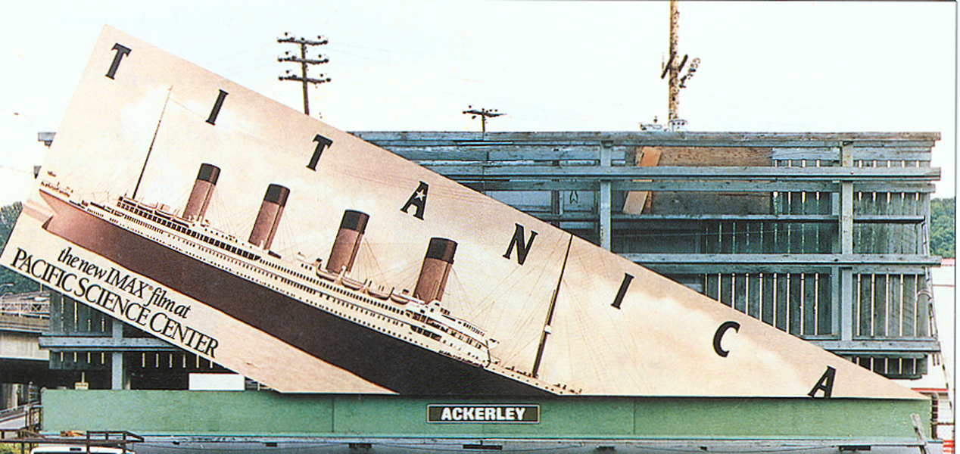

Slide 130
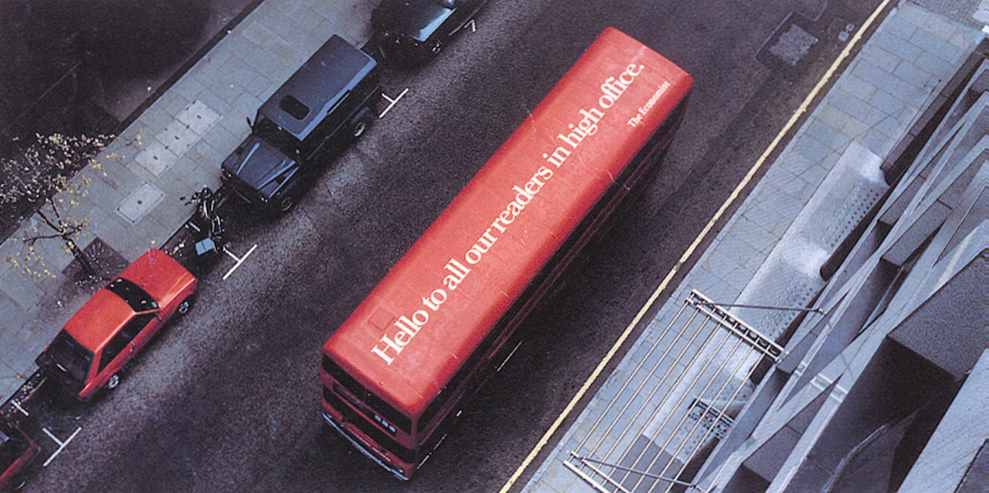
Hello to all our readers in high office.

Slide 131
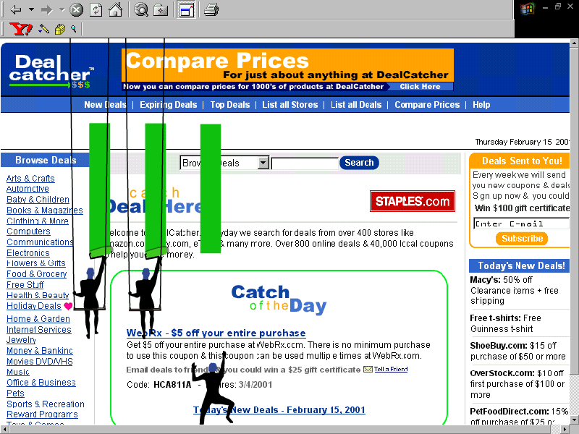

Slide 132
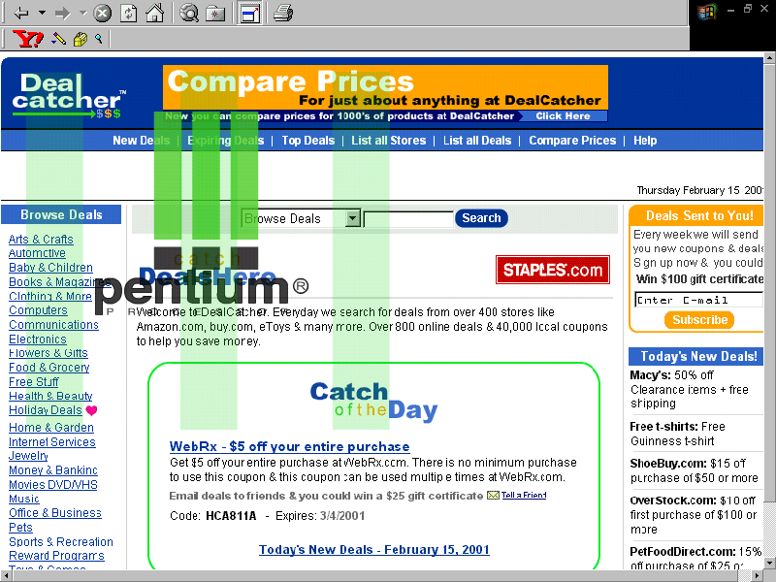

Slide 133
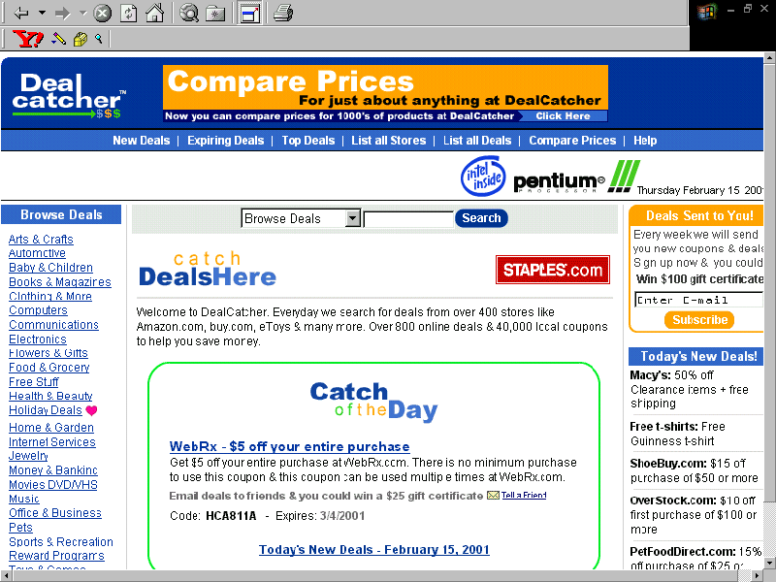

Slide 134
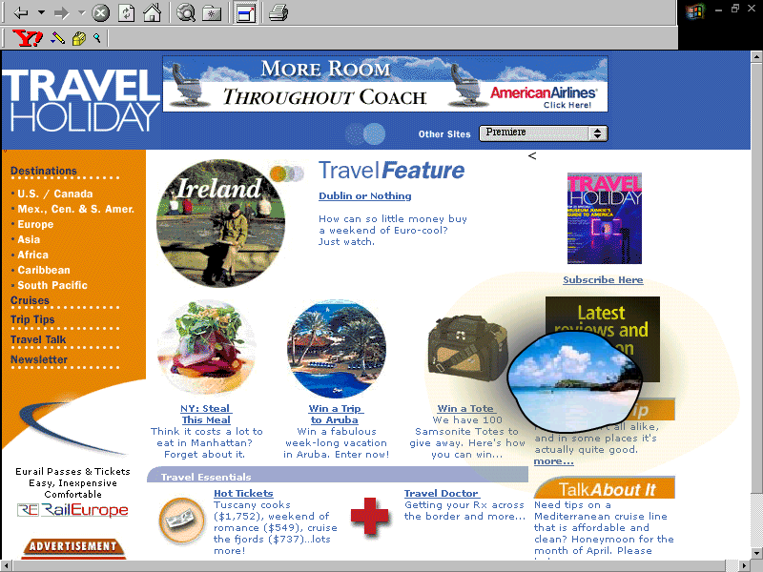

Slide 135
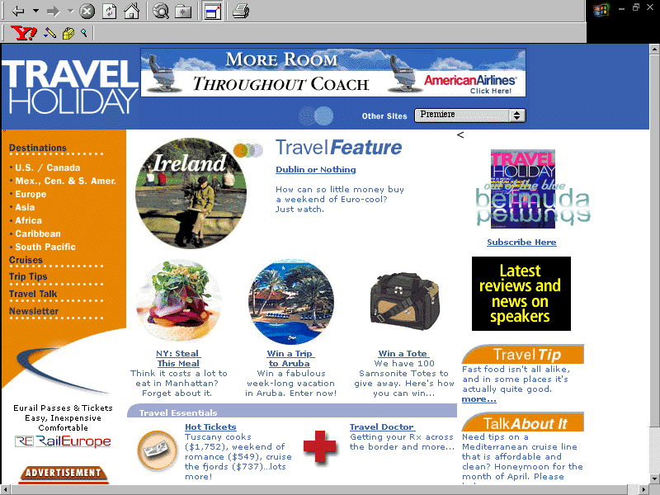

Slide 136
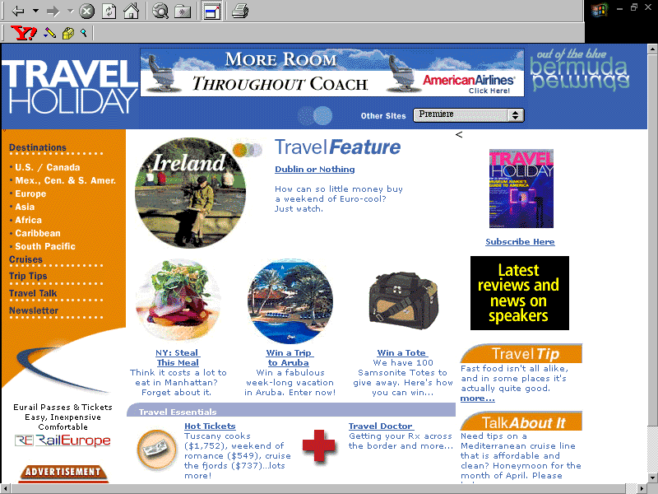

Slide 137
Multiplying the
Power of Persuasion
Adding value to the Branding Idea
Strategic media decisions made prior to creative development
  Early involvement with creative teams
Free Your Mind!!!

Slide 139
MEDIA OPERATIONAL PROCEDURES

Slide 140
WORK FLOW

Slide 141
PRESENT SCENARIO
Approved Media Plan
Release Orders
Material
Requisitions from Servicing for a Media estimate
Media Estimate
Approved Estimate from Client

Slide 142
IDEAL
Requisition + Approved Media Plan
Media Estimate
Approved estimate + Material
Release Orders

Slide 143
THANK YOU

